Slide 1
Spatial density and habitat associations of Atlantic Cod
Katie Lankowicz
Jon Grabowski, Graham Sherwood, Lisa Kerr

Slide 2
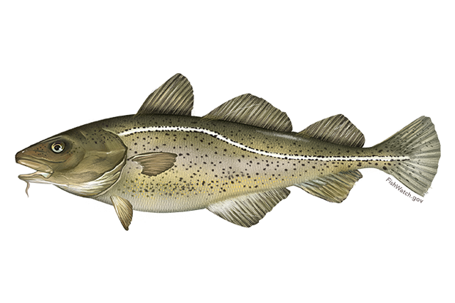
Atlantic Cod
Ecologically and culturally important species within New England’s groundfish complex
Spatial distribution of cod shaped by multiple habitat and oceanographic variables

Slide 3
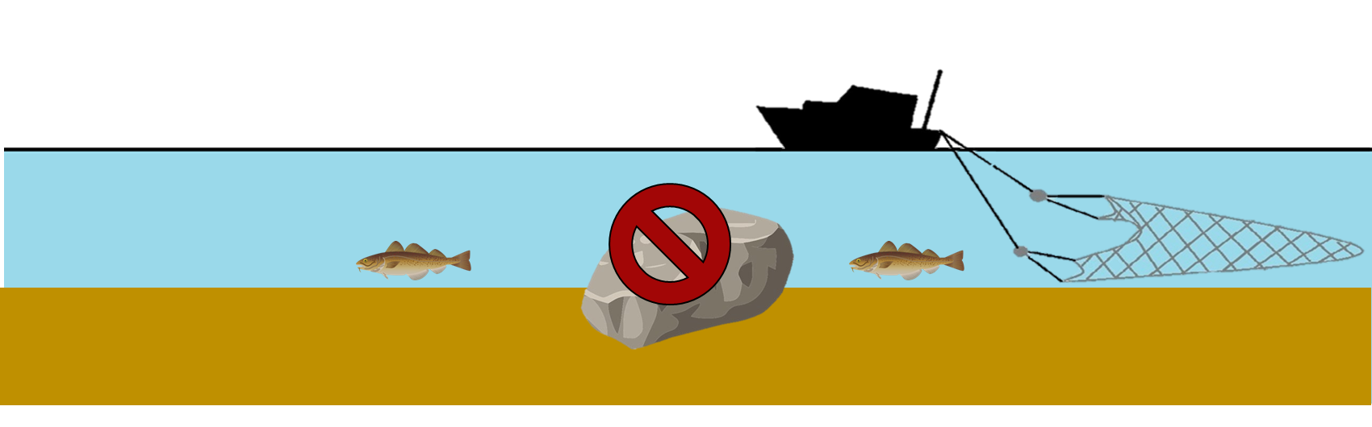
Cod assessments and habitat use
Possibility of density-dependent reduction in spatial distribution and therefore availability to fishery-independent surveys
Assessment and management efforts mainly informed by bottom trawl surveys with reduced efficiency over complex bottom habitat
Notes:
Mention industry collaboration

Slide 4

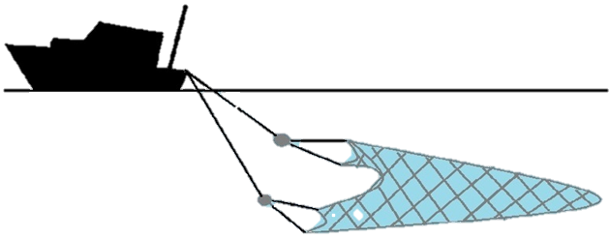
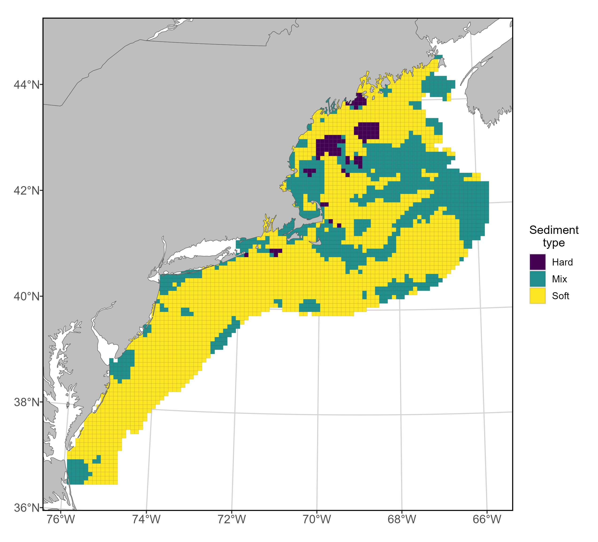
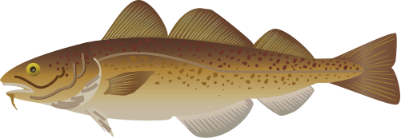
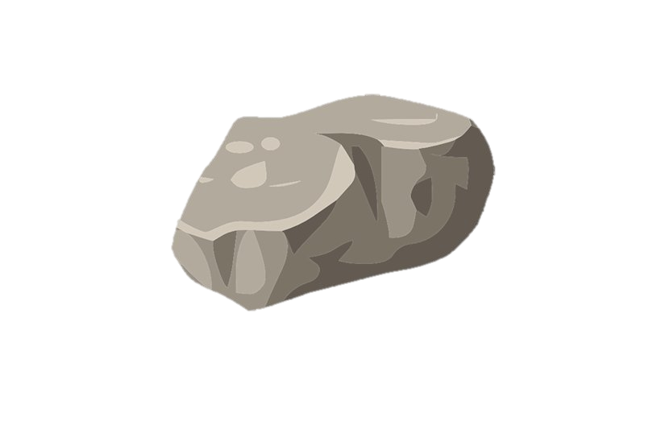
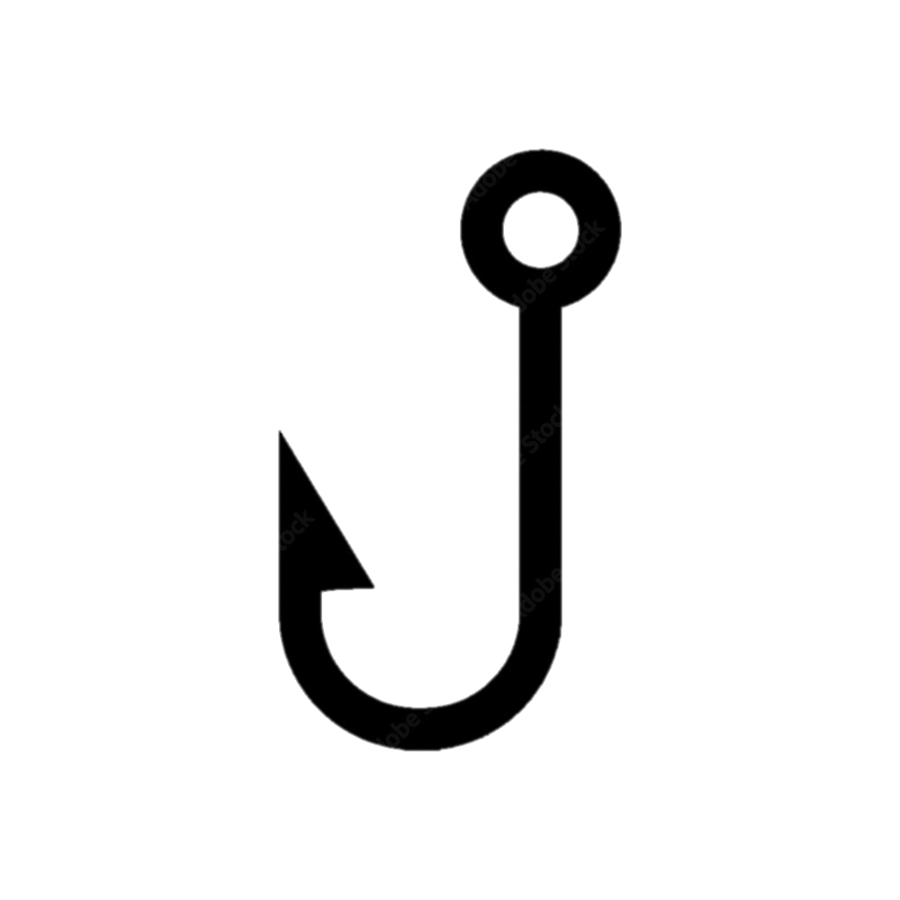
How do we fix this?
How do we fix this?

Slide 5
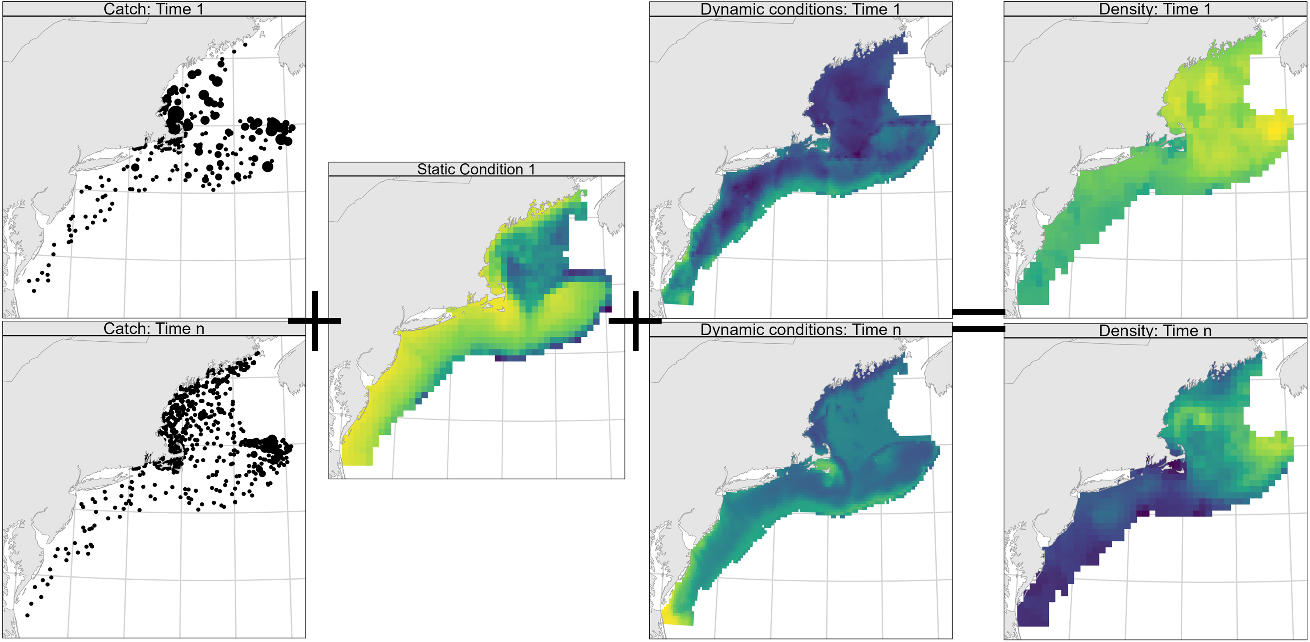
Approach
Vector Autoregressive Spatio-Temporal Model (VAST)
Notes:
Objectives: map spatial density, generate indices of abundance, identify habitat associations, identify shifts in spatial dynamics
Designed to estimate spatial variation in density of one or more categories in one or more time steps.
spatial dynamics

Slide 6
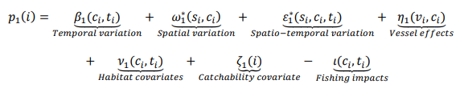
Model structure
Predictor 1: Model encounter probability at every spatial location and time step for each category
Predictor 2: Model positive catch rate at every spatial location and time step for each category, based on the calculated encounter probability
Notes:
Spatial delta-generalized linear mixed model for multiple categories

Slide 7
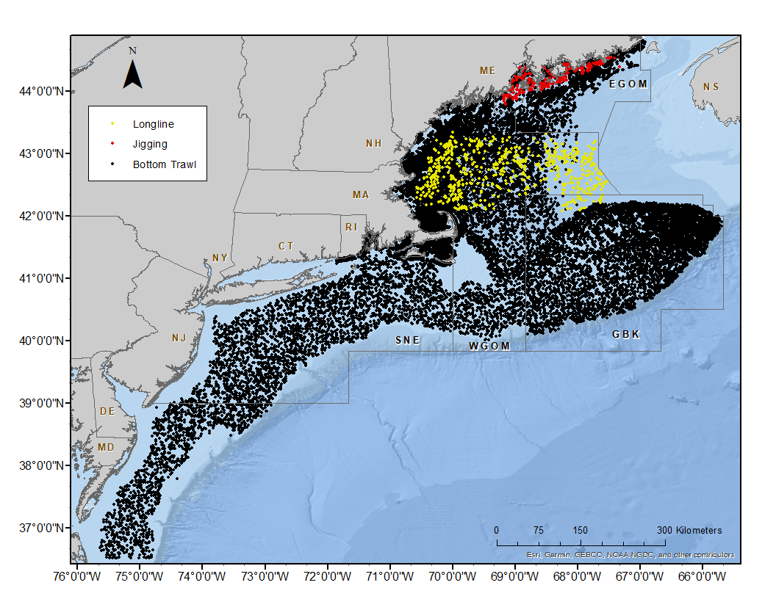
Surveys
11 surveys
Multiple gear types
40 years
(1982 – 2021)
Number and size information of cod caught at each sampling location
Area-swept effort information
Notes:
Dropped jigging survey, sensitivity analysis provided evidence that it wasn’t contributing much to model fit anyway.

Slide 8


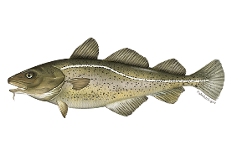
Model setup
Time steps
Size classes
1982 - 2021
March-August
September-February
Small
(< 40cm)
Medium
(40-70 cm)
Large
(>70 cm)

Slide 9
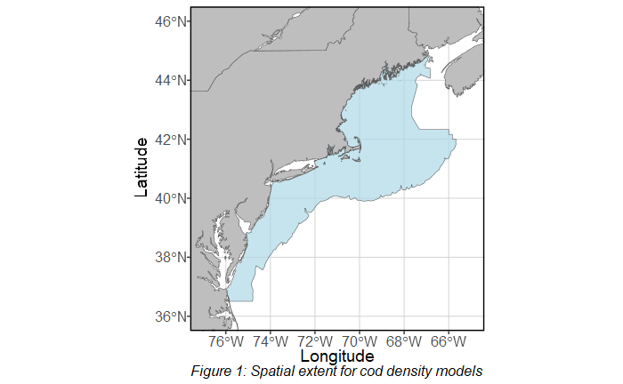
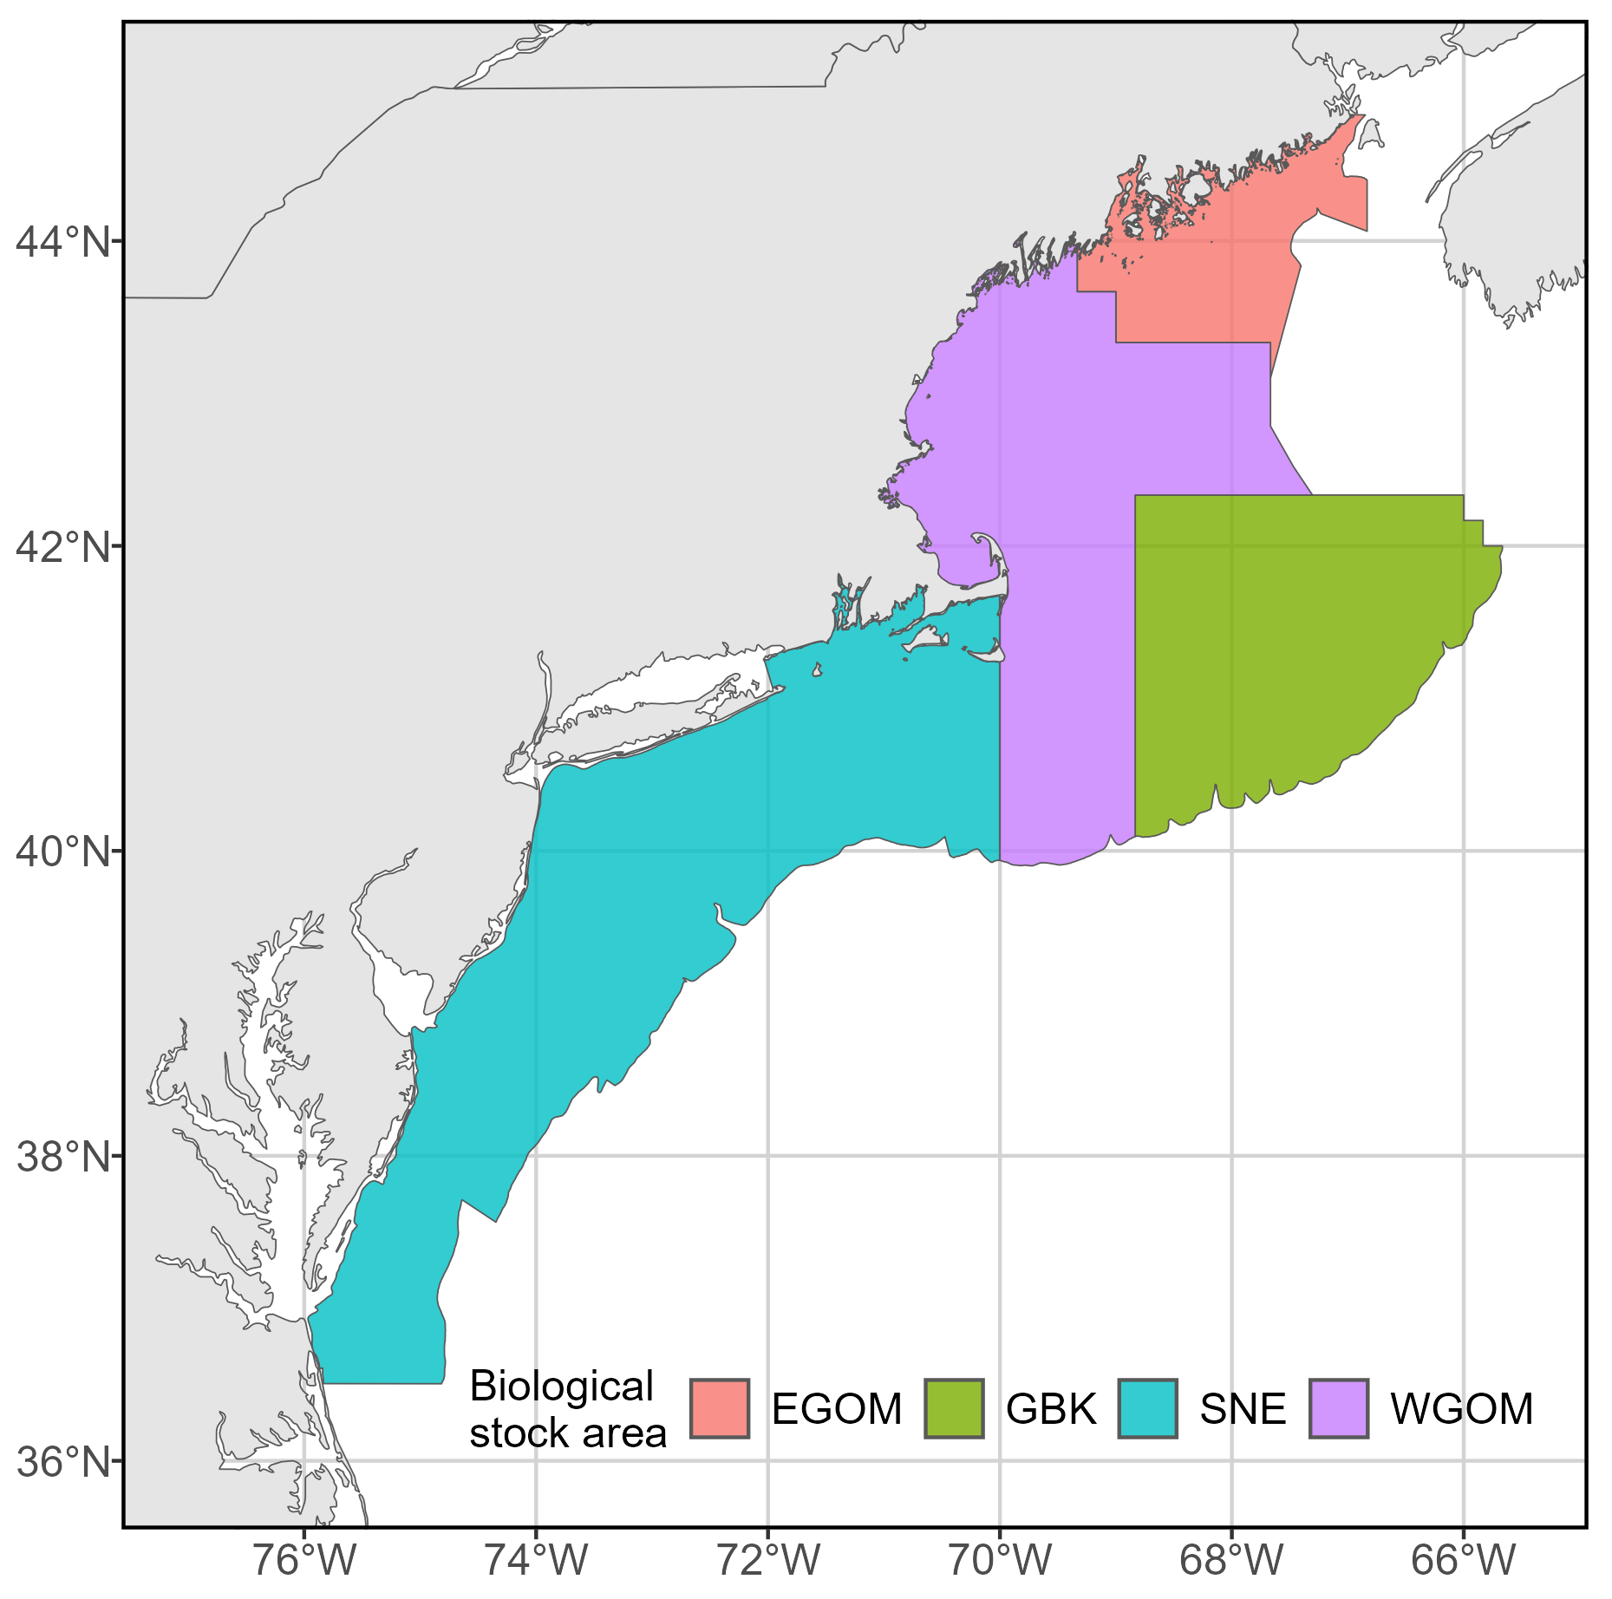
Spatial domain
Northeast US continental shelf
4 strata: Eastern Gulf of Maine, Western Gulf of Maine, Georges Bank, and Southern New England
Stock area geographic boundaries redefined in 2021 by cod research track group to align with population structure
200-knot SPDE mesh
Force 2,000 grid cells: each ~25km by 25km
Notes:
Redefined recently to align with population structure
Implications for fishery data- survey strata

Slide 10
Density covariates
Tested for collinearity prior to inclusion
Probability of sediment type: sand, mud, gravel, cobble
Rugosity
Bathymetry
Daily bottom temperature
Basin-wide climate indices: daily NAO index, monthly AMO index
Natural spline additive model for both predictors
Response variable ~ s(Density Covariate 1) + … + s(Density Covariate n)

Slide 11
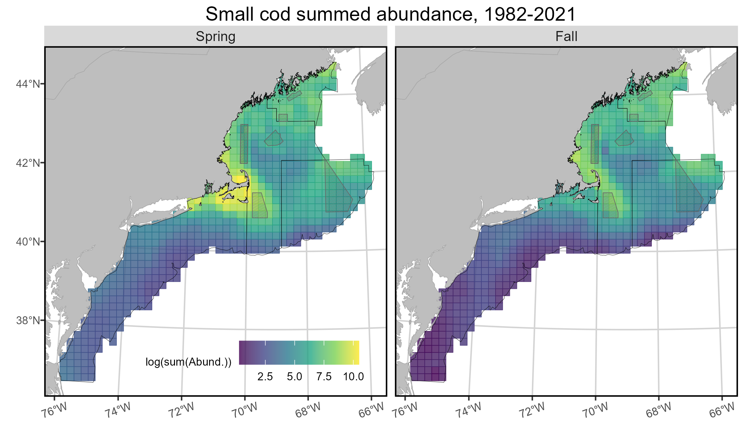
Spatial distribution patterns

Slide 12
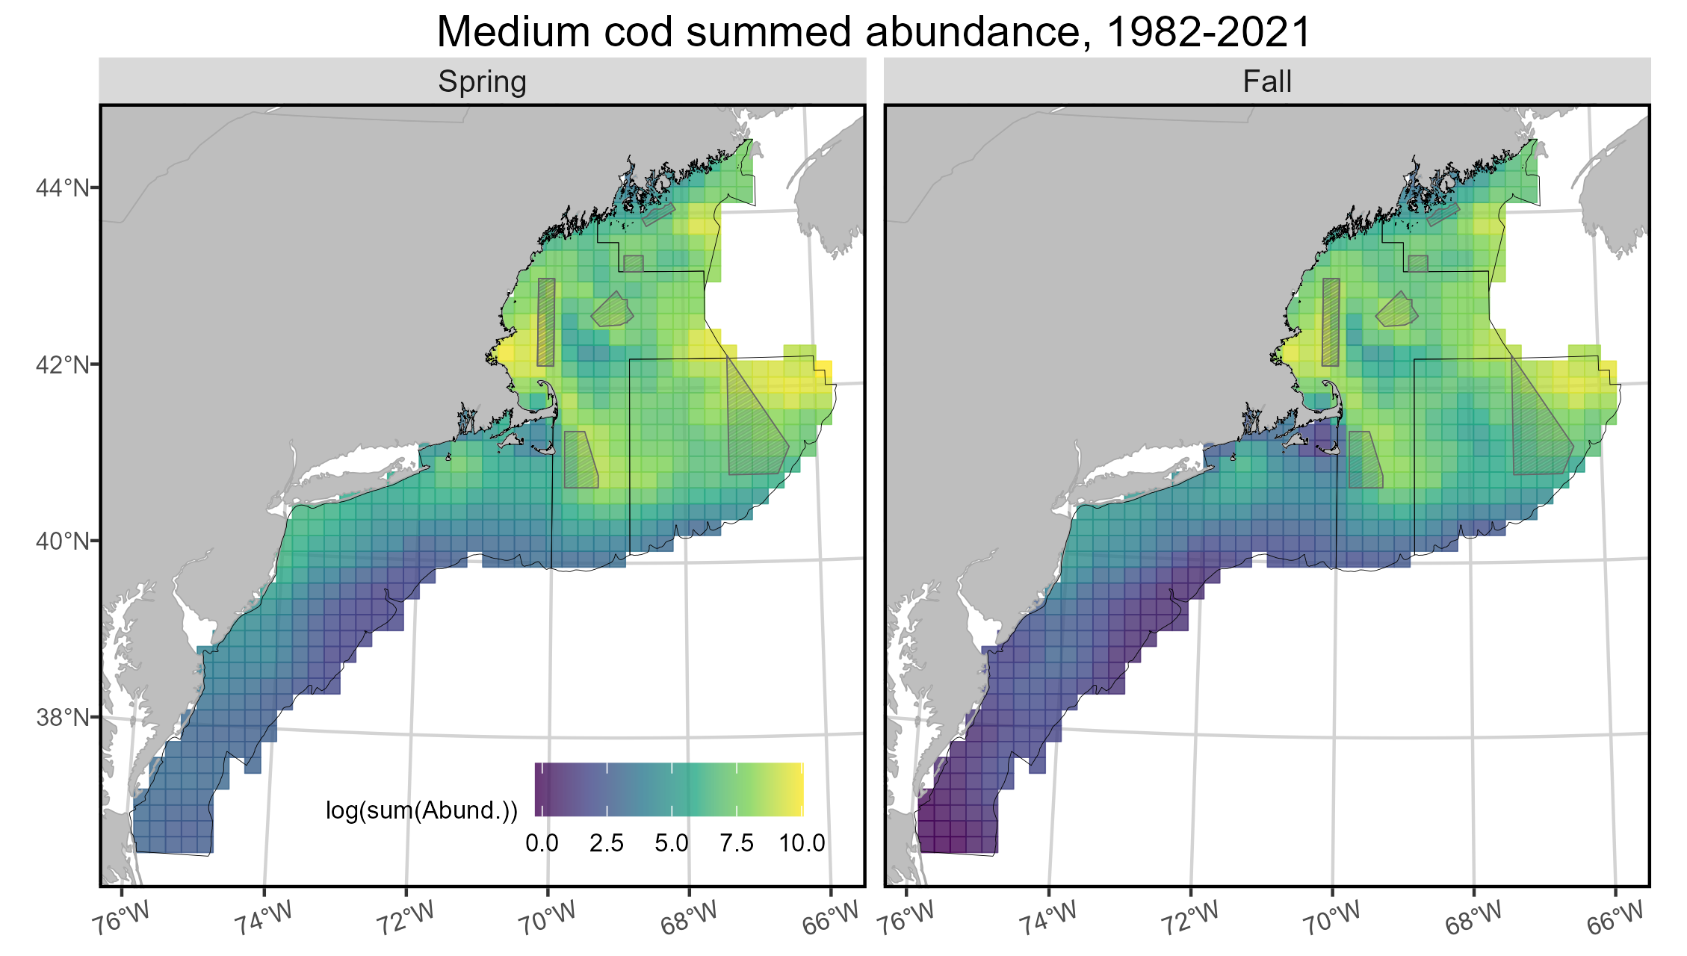
Spatial distribution patterns

Slide 13
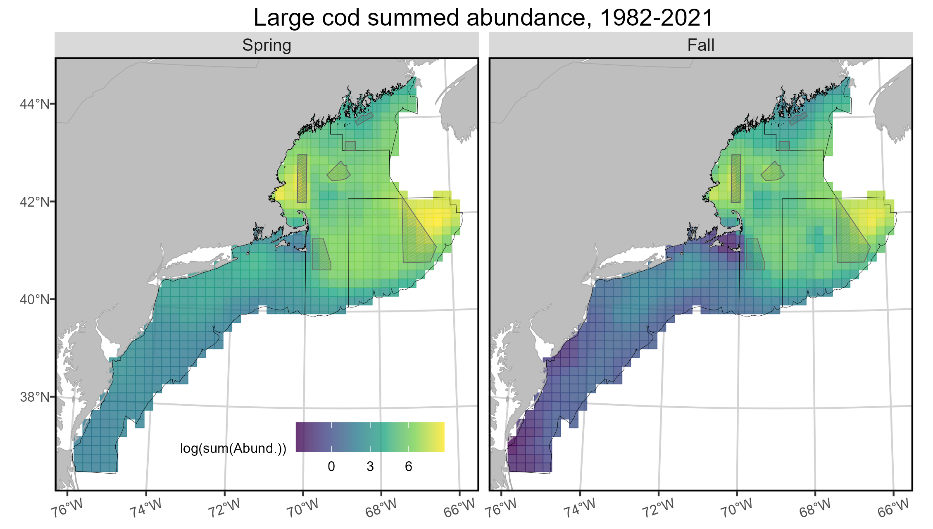
Spatial distribution patterns

Slide 14
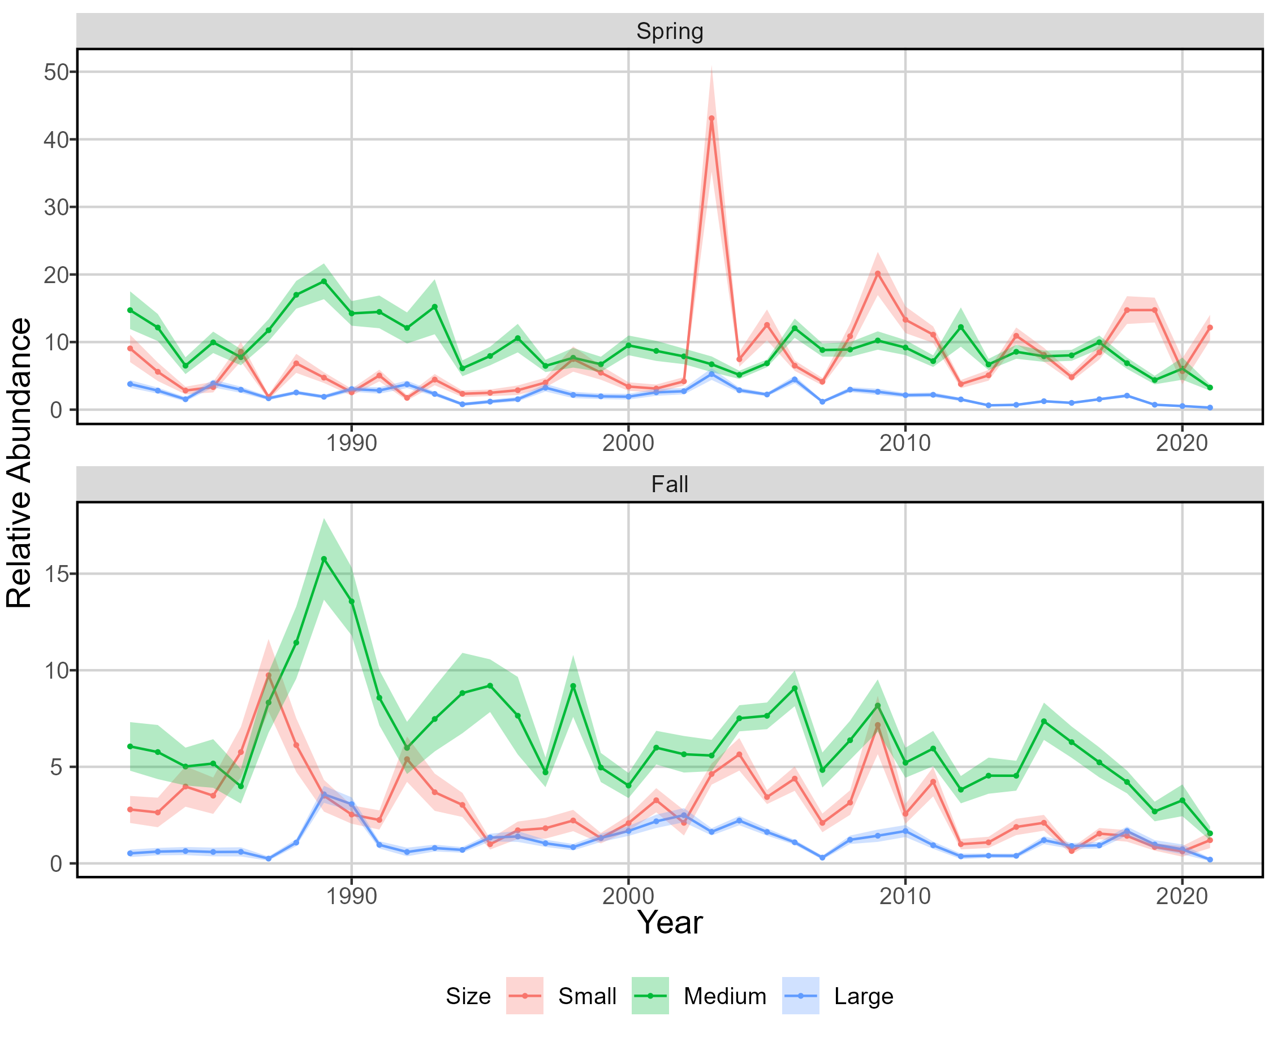
Indices of relative abundance
MODELS NOT TESTED AGAINST DESIGN-BASED INDICES
APPROPRIATENESS OF MODEL SCALING NOT ASSESSED
DO NOT USE AS ABSOLUTE ABUNDANCE, USE AS RELATIVE ABUNDANCE

Slide 15
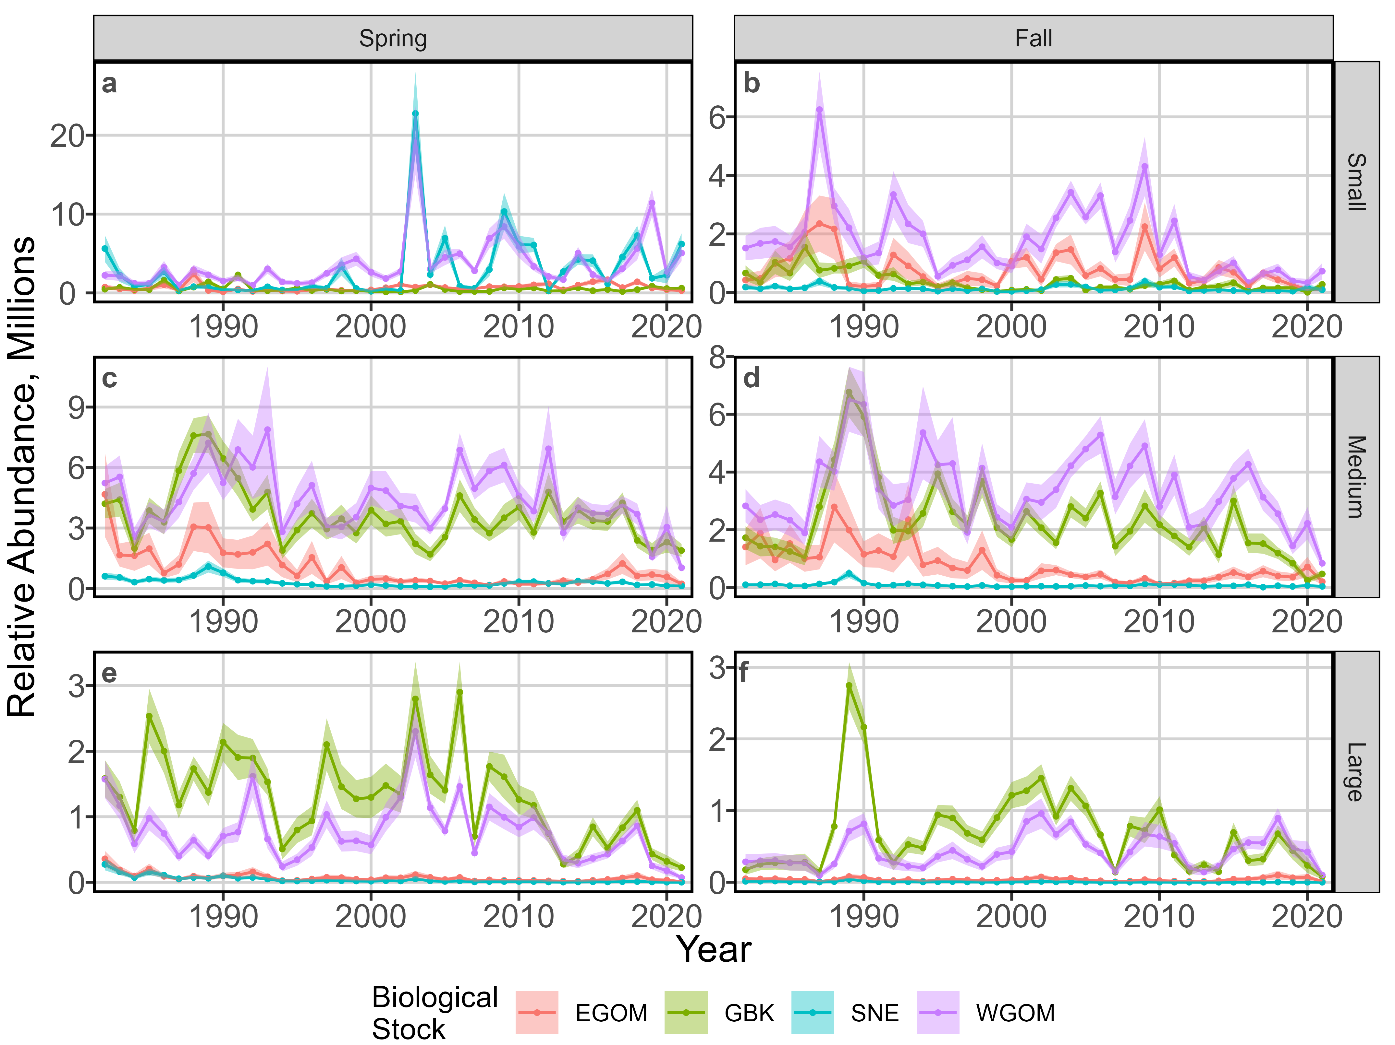
Indices of relative abundance

Slide 16
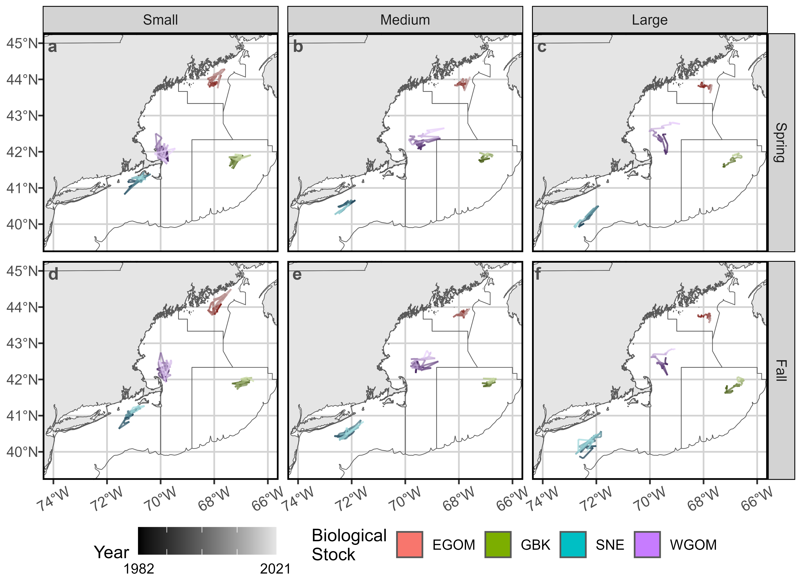
Spatial dynamics

Slide 17
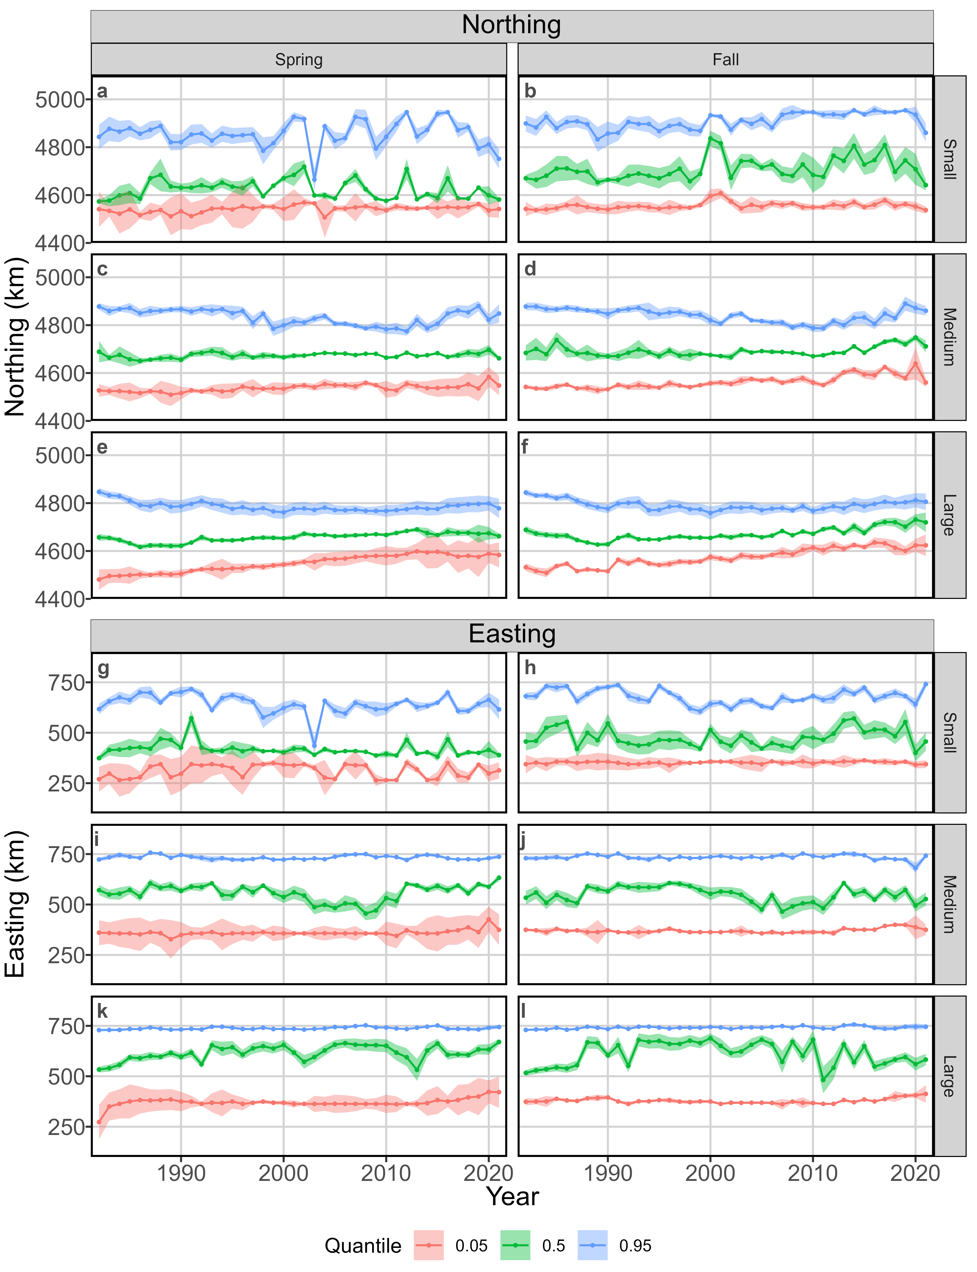
Spatial dynamics

Slide 18
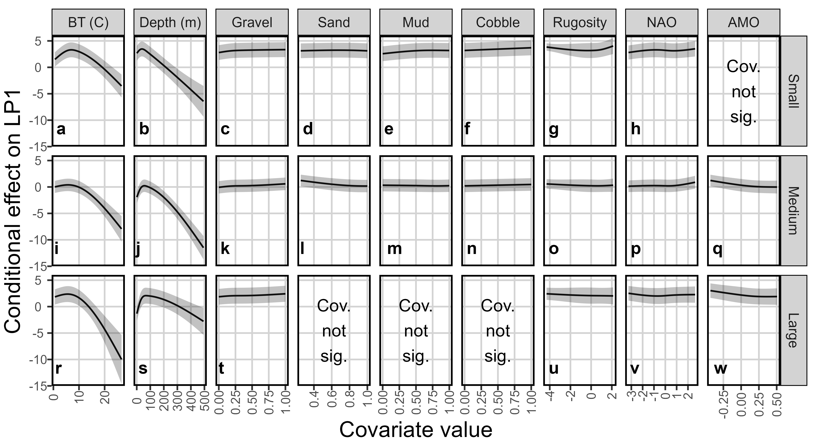
Habitat associations
Large size class, presence/absence

Slide 19
Conclusions
VAST is a flexible model framework
Capable of combining multitudes of data and generating spatial dynamics information pertinent to ecological and stock assessment research
Spatial density is variable across the size classes and within the stock areas
North-south and inshore-offshore gradients of abundance linked to size
Indices of abundance for all size classes generally declined over the modeled period in all stock areas
Small size class showed high variability and possible increasing trend in spring

Slide 20
Conclusions
Stock centers of gravity shifting northeast, particularly in fall
North-south habitat compression for medium and large size classes
Strength of habitat associations variable with size
Depth and bottom temperature most important across all size classes
Other tested covariates significant for only some size classes

Slide 21
Implications
Persistent patches of high density in certain areas despite declining abundance supports the “basin model”
Will be important to quantify reduction of suitability, reduction of spatial area, or movement of these “basins” with warming temperatures
Model derives habitat association information that could be used to inform novel survey designs (i.e. dynamic stratification)
Increased within-strata homogeneity increases precision of design-based indices of abundance

Slide 22

Acknowledgements
Lisa Kerr
Graham Sherwood
Jon Grabowski
Jackie Odell
Vito Giacalone
Felipe Restrepo
Brad Harris
Hubert duPontavice
Andrew Allyn
Alex Hansell
Staff and survey managers at:
DFO
NOAA NEFSC
ASMFC Northern shrimp trawl
ME-NH Inshore trawl
Eastern Gulf of Maine Sentinel survey
SMAST video trawl survey
MA DMF
URI GSO Trawl
RI DEM

Slide 23


: klankowicz@gmri.org
: @klankowicz.bsky.social

